Slide 1

Client Handling Skills
How to make sure the customer service team is skilled, empathetic, and engaged

Slide 2
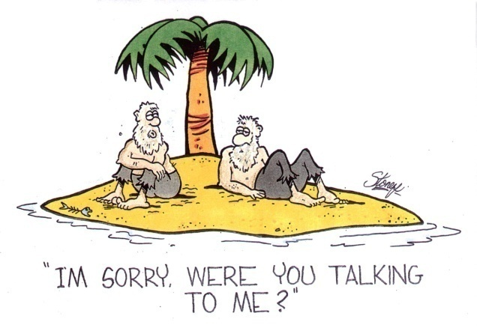
Active listening is ……………………
A. listening while staying active by running, jogging, etc.
B. listening while maintaining eye contact with the speaker
C. listening while the speaker is talking, but interrupting as soon as possible, so that you are participating in the conversation
D. listening and responding to the other person in a way that improves mutual understanding
E. listening and using positive body language

Slide 3
You place a customer on hold, after telling her that it will take two minutes for you to look for the information she requires. You realize after two minutes that it will take a bit longer than you thought to find the information. What should you do?
A. Go back to the caller to tell her that it will take a bit longer, and ask if she minds holding for a few more min
B. Continue to look for the information.
C. Go back to the caller and advise her to hang up. Let her know that you will call her back after you have found the information
D. Go back to the caller and advise her to call you back later, because you couldn't find the information she wanted
E. Go back to the caller and say, "Please hold for a few more minutes." Then, press the hold button again

Slide 4
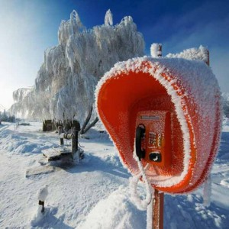
"Cold-transferring a call" is ___.?
A. transferring a call when the equipment is cold
B. transferring a customer with a cold attitude
C. transferring a call to another phone number, when the call is not expected
D. transferring a rude caller to the manager's phone
E. transferring the call to another phone number, without waiting for the call to be answered

Slide 5
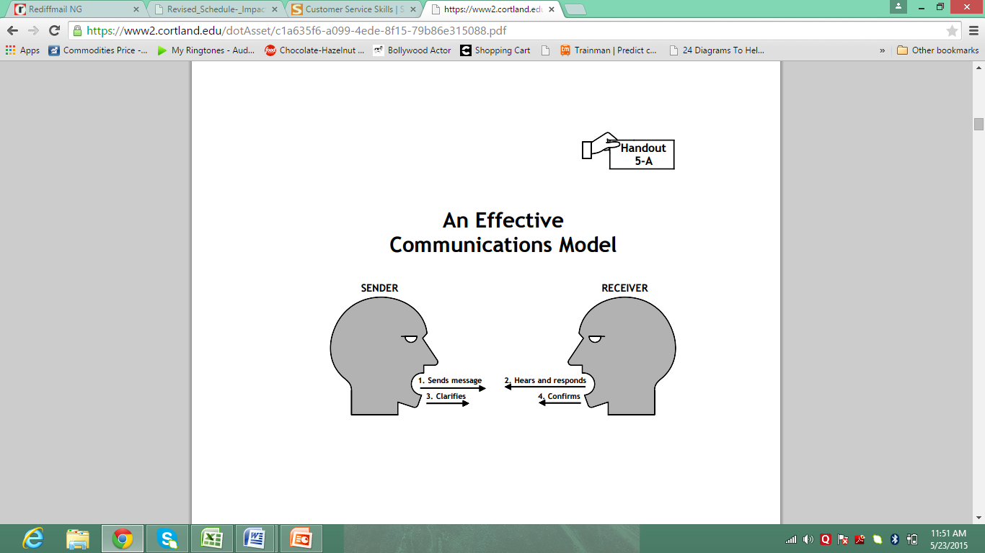

Slide 6

Strengthen your customer service skills
Empathy, patience and consistency.
Adaptability.
Clear communication.
Work ethic.
Knowledge

Slide 7
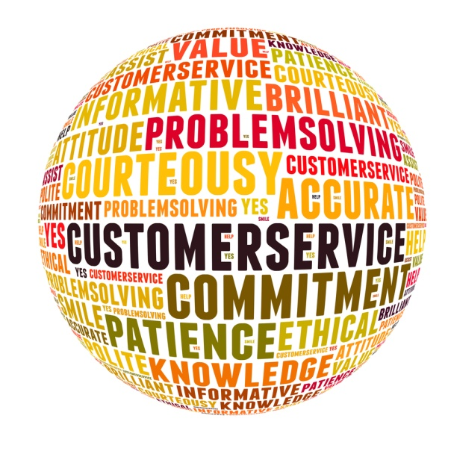
Attentiveness
Knowledge of the Product
Ability to Use "Positive Language"
Time Management Skills
Ability to "Read" Customers
Closing Ability

Slide 8

Positive Words
1. Definitely
2. Surely
3. Absolutely
4. Certainly
5. Fantastic
Example Use
• I definitely will make sure that it gets sorted…
• You will surely be able to enjoy…
• I absolutely agree…
• I can certainly help you…
• That is a fantastic alternative…

Slide 9

Everyday phrases
“Rest assured Mr……”
“I do understand the inconvenience you have faced……”
“I will be more than glad/ happy to assist you….”
“I completely understand the reason why / your situation….”
“I will ensure that…”
“What I will do for you right away is……”
“I assure you I will try my best…..”
“What I can do for you right now is ….”
“I’m sorry for the inconvenience that you have faced, what I can do for you is ….”

